Slide 1
BT2102
Assignment 1
Group 35
Members: Lee Chin Juan, Pae En Yang, Lee Chen Xi,
Sim Wee Yang, Eugene Lim, Brigitte Puteri Santoso

Slide 2
1
Conceptual Design

Slide 3
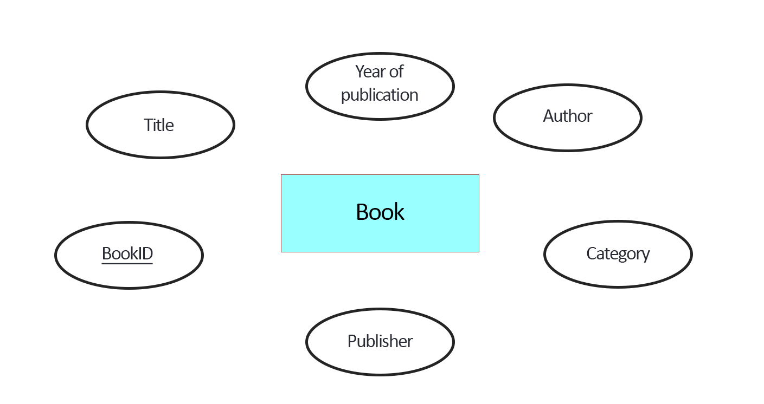
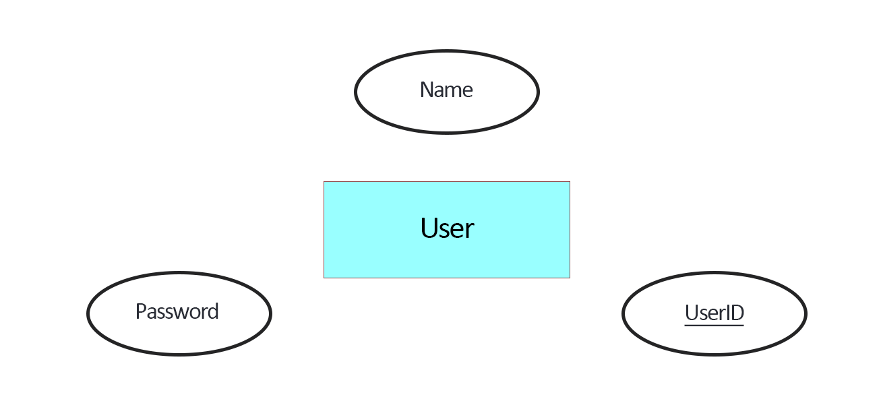
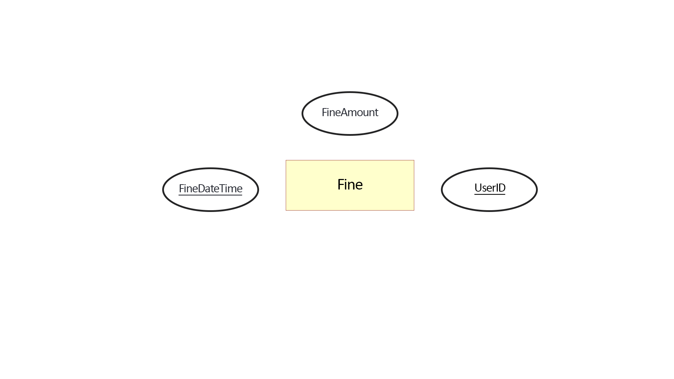
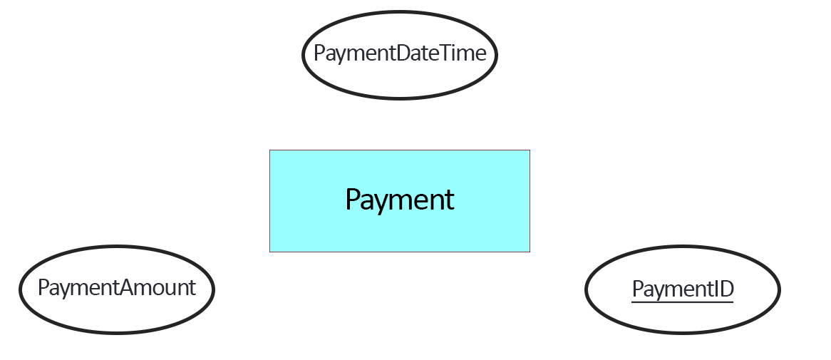
Identifying Entities and Attributes
Note: Primary Key is underlined
Entity (Strong): Book
Entity (Strong): User
Entity (Weak): Fine
*Weak entity of User
Entity (Strong): Payment

Slide 4
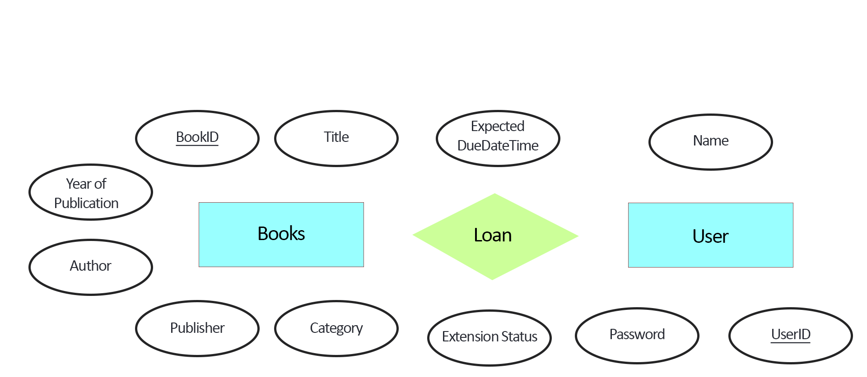
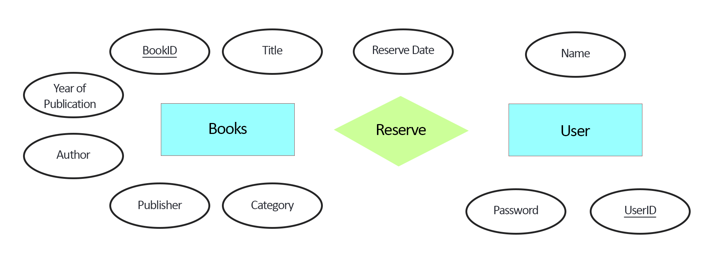
Identifying Relationships and Attributes
User LOAN Books (1:N)
User RESERVE Books (1:N)

Slide 5
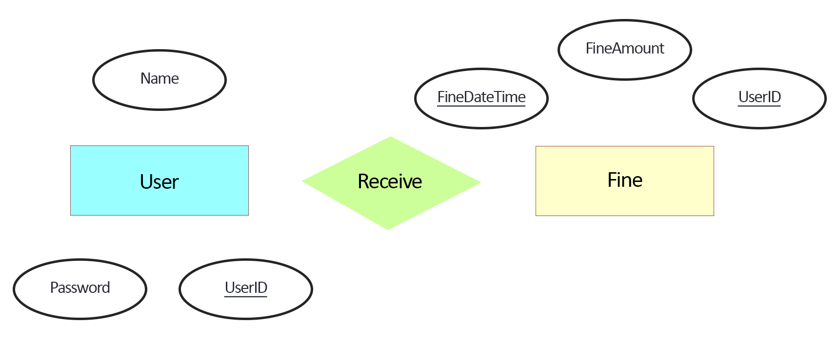
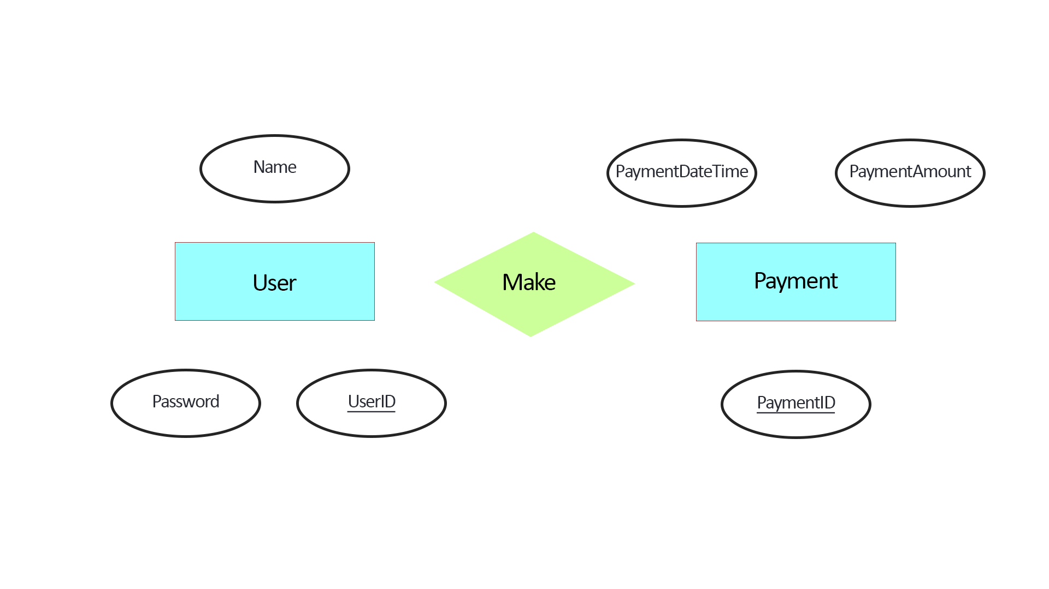
Identifying Relationships and Attributes
User RECEIVE Fine (1:N)
User MAKE Payment (1:N)

Slide 6
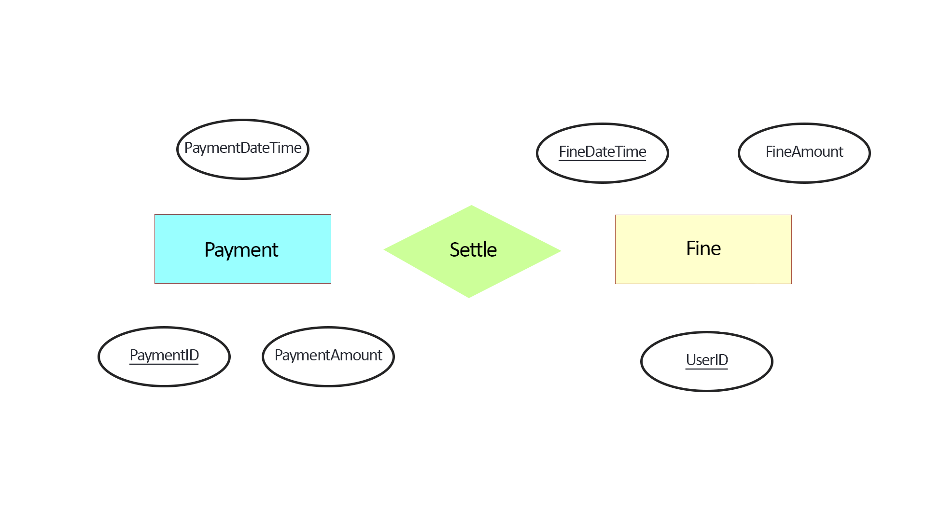
Identifying Relationships and Attributes
Payment SETTLE Fine (1:1)
Optional Participation by Payment

Slide 7
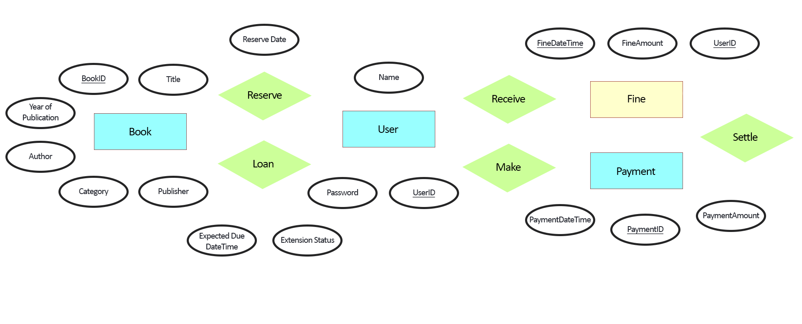
Complete ER Diagram
Note: Primary Key is underlined
Legend: Solid Rectangles represent entities, Double rectangles represent weak entity, Diamonds represent relationships, Ovals represent attributes , Symbols (1, N) represent the cardinality, Single-line shows mandatory participation and Double-line shows optional participation, Primary Keys are underlined.
ER Diagram in Chen’s Notation

Slide 8
2
Create Relational Schema for Strong Entities

Slide 9
BOOK
Book(BookID, Title, Year of Publication, Author, Publisher, Category)
Primary Key: BookID

Slide 10
USER
User(UserID, Name, Password)
Primary Key: UserID

Slide 11
PAYMENT
Payment(PaymentID, PaymentDateTime, PaymentAmount)
Primary Key: PaymentID

Slide 12
Relational Schema for Strong Entities
Book(BookID, Title, Year of Publication, Author, Publisher, Category)
User(UserID, Name, Password)
Payment(PaymentID, PaymentDateTime, PaymentAmount)

Slide 13
3
Create Relational Schema for Weak Entities

Slide 14
FINE
Fine(UserID, FineDateTime, FineAmout)
Primary Key: (UserID, FineDateTime)
Note: Fine is a weak entity of User, it will take in the Primary Key of User: UserID

Slide 15
Relational Schema for Weak Entities
Fine(UserID, FineDateTime, FineAmount)

Slide 16
4
Create Relational Schema for Relationship

Slide 17

LOAN
User LOAN Book (1:N)
Loan(BookID, UserID, ExpectedDueDate, ExtensionStatus)
Primary Key: BookID

Slide 18

RESERVE
User RESERVE Book (1:N)
Reserve(BookID, UserID, ReserveDate)
Primary Key: BookID

Slide 19
SETTLE
Payment SETTLE FINE (1:1)
Optional Participation by Payment
Settle(PaymentID, UserID)
Primary Key: PaymentID

Slide 20
MAKE
User Make Payment (1:N)
Make(PaymentID, UserID)
Primary Key: PaymentID

Slide 21
Relational Schema for Relationship
Loan(BookID, UserID, ExpectedDueDate, ExtensionStatus)
Reserve(BookID, UserID, ReserveDate)
Settle(PaymentID, FineUserID, FineDateTime)
Make(PaymentID, UserID)

Slide 22
Entity and Relationship Schema
Book(BookID, Title, Year of Publication, Author, Publisher, Category)
User(UserID, Name, Password)
Payment(PaymentID, PaymentDateTime, PaymentAmount)
Fine(UserID, FineDateTime, FineAmount)
Loan(BookID, UserID, ExpectedDueDate, ExtensionStatus)
Reserve(BookID, UserID, ReserveDate)
Settle(PaymentID, FineUserID, FineDateTime)
Make(PaymentID, UserID)

Slide 23
5
Refine Relational Schema

Slide 24
BEFORE
AFTER
Combining Relationship
Book(BookID, Title, Year of Publication, Author, Publisher, Category)
User(UserID, Name, Password)
Payment(PaymentID, PaymentDateTime, PaymentAmount)
Fine(UserID, FineDateTime, FineAmount)
Loan(BookID, UserID, ExpectedDueDate, ExtensionStatus)
Reserve(BookID, UserID, ReserveDate)
Settle(PaymentID, FineUserID, FineDateTime)
Make(PaymentID, UserID)
Book(BookID, Title, Year of Publication, Author, Publisher, Category, UserID, ExpectedDueDate, ExtensionStatus, ReserveDate)
User(UserID, Name, Password)
Payment(PaymentID, PaymentDateTime, PaymentAmount, UserID, FineUserID, FineDateTime)
Fine(UserID, FineDateTime, FineAmount)
Combining
Note: Attributes highlighted in RED refers to the newly added attributes from the relationship after combining

Slide 25
BEFORE
AFTER
Normalization
Book(BookID, Title, Year of Publication, Author, Publisher, Category, UserID, ExpectedDueDate, ExtensionStatus, ReserveDate)
Note: Transitive Dependencies in Book therefore normalization required to achieve 3NF. (ExpectedDueDate, ExtensionStatus, ReserveDate will cause update anomalies)
Book(BookID, Title, Year of Publication, Author, Publisher, Category)
LoanStatus(BookID, UserID, ExpectedDueDate, ExtensionStatus)
ReserveStatus(BookID, UserID, ReserveDate)
Normalize

Slide 26
BEFORE
AFTER
After Combining and Normalizing
Book(BookID, Title, Year of Publication, Author, Publisher, Category)
User(UserID, Name, Password)
Payment(PaymentID, PaymentDateTime, PaymentAmount)
Fine(UserID, FineDateTime, FineAmount)
Loan(BookID, UserID, ExpectedDueDate, ExtensionStatus)
Reserve(BookID, UserID, ReserveDate)
Settle(PaymentID, FineUserID, FineDateTime)
Make(PaymentID, UserID)
Book(BookID, Title, Year of Publication, Author, Publisher, Category)
User(UserID, Name, Password)
Payment(PaymentID, PaymentDateTime, PaymentAmount, UserID, FineUserID, FineDateTime)
Fine(UserID, FineDateTime, FineAmount)
LoanStatus(BookID, UserID, ExpectedDueDate, ExtensionStatus)
ReserveStatus(BookID, UserID, ReserveDate)
Combine +
Normalise

Slide 27
5
The Final Relational Schema

Slide 28
Final Relational Schema
Book(BookID, Title, Year of Publication, Author, Publisher, Category)
User(UserID, Name, Password)
Payment(PaymentID, PaymentDateTime, PaymentAmount, UserID, FineUserID, FineDateTime)
Fine(UserID, FineDateTime, FineAmount)
LoanStatus(BookID, UserID, ExpectedDueDate, ExtensionStatus)
ReserveStatus(BookID, UserID, ReserveDate)

Slide 29
Fine(UserID, FineDateTime, FineAmount)
Primary Key: (UserID, FineDateTime)
Foreign Key: UserID References User(UserID)
LoanStatus(BookID, UserID, ExpectedDueDate, ExtensionStatus)
Primary Key: (BookID, UserID)
ReserveStatus(BookID, UserID, ReserveDate)
Primary Key: (BookID, UserID)
Book(BookID, Title, Year of Publication, Author, Publisher, Category)
Primary Key: BookID
User(UserID, Name, Password)
Primary Key: UserID
Payment(PaymentID, UserID
PaymentDateTime, PaymentAmount, FineUserID, FineDateTime)
Primary Key: PaymentID
Foriegn Key: UserID References User(UserID)
Foreign Key: (FineUserID, FineDateTime) References Fine(UserID, FineDateTime)

